Slide 1

Weekly Review
09/03/21
Tasks
Custom Implementation : Cloth environment with SAC approach⚠️In progress
Prepare SAC Pipeline Explanation 🗸
To-Do Items for Next Week
Finish custom Implementation : Cloth environment integrate to SAC approach
Modify cloth initialization in simulation
To-Do Later
Define reward function and action for new use case
Explore usage of intermediate testing on simulation before sim-to-real transfer
Define use-case (for different type of towels (colour, texture, etc. ) / one type )
Check the no. of episodes needed, check computational requirements

Slide 2
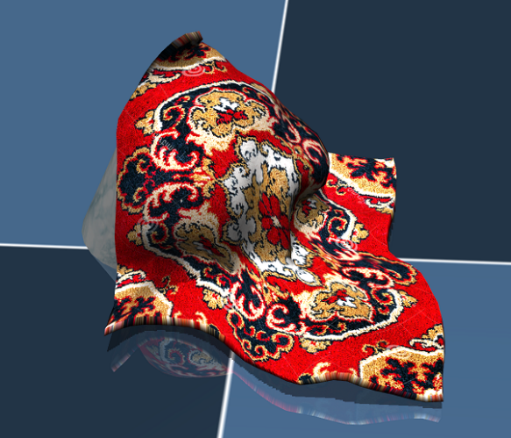
Cloth Manipulation – RL Problem
02/03/21
State/Observation
, Reward
Agent
Action
Goal of RL Agent is to
maximize expected reward
Environment (Mujoco)

Slide 3
Cloth Manipulation using random policy
02/03/21
Policy (state - action)=
Random action in a specific range
Observation
(64*64 img)
Action
Pick point and place point
From random pixel points
Inside segmented mask
Agent
Reward
(Overlap with goal state)
Environment (Mujoco)

Slide 4
Cloth Manipulation using SAC
02/03/21
SACAgent
Observation
(64*64 img)
Action
Pick point and place point
From random pixel points
Inside segmented mask
Agent
Reward
(Overlap with goal state)
Environment (Mujoco)

Slide 5
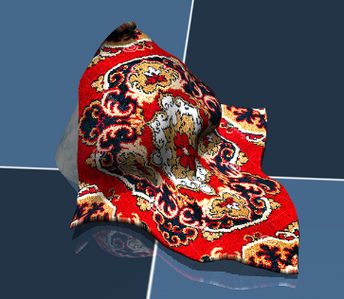
STEP 1 : Sample actions from value network and store state, action, reward, next state, done in Experience Replay Buffer
State -> Actor Network -> Action
State, action -> Critic Network 1 ->
Quality of action
State, action -> Critic Network 2 -> Quality of action
State -> Value Network -> Value
State, action -> Target Value Network -> Value
Separate V and Q networks help in convergence
Action sampled
From mean, variance
Value
Network
( ψ)
Target
Network
( ψ)
Policy
Network
(ϕ)
Critic 1
Network
(θ)
Critic 1
Network
(θ)
ExperienceReplay
Buffer
High Entropy
Maximize Exploration
Equal probabilities to
Actions that have same or nearly same Q-values
Maximize the reward + entropy of the policy
State, action, reward, next state, done
SAC Agent
Action
Pick point
Place point
Observation
(64*64 img)
Environment (Mujoco)

Slide 6
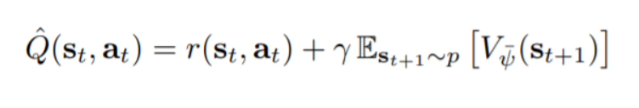
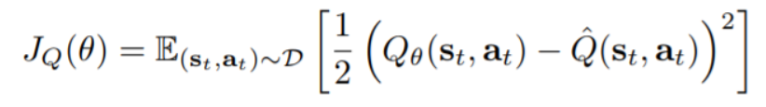
STEP 2 : We train the Quality Network by minimizing the following error
State -> Actor Network -> Action
State, action -> Critic Network 1 ->
Quality of action
State, action -> Critic Network 2 -> Quality of action
State -> Value Network -> Value
State, action -> Target Value Network -> Value
Separate V and Q networks help in convergence
Value
Network
( ψ)
Target
Network
( ψ)
Policy
Network
(ϕ)
Critic 1
Network
(θ)
Critic 1
Network
(θ)
ExperienceReplay
Buffer
Two networks are taken to avoid overestimation of Q values
High Entropy
Maximize Exploration
Equal probabilities to
Actions that have same or nearly same Q-values
Maximize the reward + entropy of the policy
State, action, reward, next state, done
SAC Agent
Action
Pick point
Place point
Observation
(64*64 img)
Environment (Mujoco)

Slide 7
STEP 3 : We train the Value Network by minimizing the following error
State -> Actor Network -> Action
State, action -> Critic Network 1 ->
Quality of action
State, action -> Critic Network 2 -> Quality of action
State -> Value Network -> Value
State, action -> Target Value Network -> Value
Separate V and Q networks help in convergence
Value
Network
( ψ)
Target
Network
( ψ)
Policy
Network
(ϕ)
Critic 1
Network
(θ)
Critic 1
Network
(θ)
ExperienceReplay
Buffer
High Entropy
Maximize Exploration
Equal probabilities to
Actions that have same or nearly same Q-values
Maximize the reward + entropy of the policy
State, action, reward, next state, done
SAC Agent
Action
Pick point
Place point
Observation
(64*64 img)
Environment (Mujoco)

Slide 8
STEP 4 : We update the Target Network
State -> Actor Network -> Action
State, action -> Critic Network 1 ->
Quality of action
State, action -> Critic Network 2 -> Quality of action
State -> Value Network -> Value
State, action -> Target Value Network -> Value
Separate V and Q networks help in convergence
Lags the Value Network
Value
Network
( ψ)
Target
Network
( ψ)
Policy
Network
(ϕ)
Critic 1
Network
(θ)
Critic 1
Network
(θ)
Target for Q Network depends on V Network and vice versa
ExperienceReplay
Buffer
High Entropy
Maximize Exploration
Equal probabilities to
Actions that have same or nearly same Q-values
Maximize the reward + entropy of the policy
State, action, reward, next state, done
SAC Agent
Action
Pick point
Place point
Observation
(64*64 img)
Environment (Mujoco)

Slide 9
Plan
02/03/21
Planned
Phase 3 : Implementation : 52 days (mid Feb- early Apr)
Testing various simulation environments and selecting one : 13 days
Setting up the Reinforcement Learning Platform and Simulation environment : 9 days
Dataset generation on chosen simulation platform : 15 days
Perform Reinforcement Learning using PyTorch : 15 days
Update
Phase 3 : Implementation : 52 days (mid Feb- early Apr)
Setting up the Reinforcement Learning Platform and Simulation environment : 13 days
Prepare a custom implementation taking existing states, actions, rewards : 9 days
Redefine actions and rewards for our use case : 15 days
Test the pipeline and iterate : 15 days

Slide 10
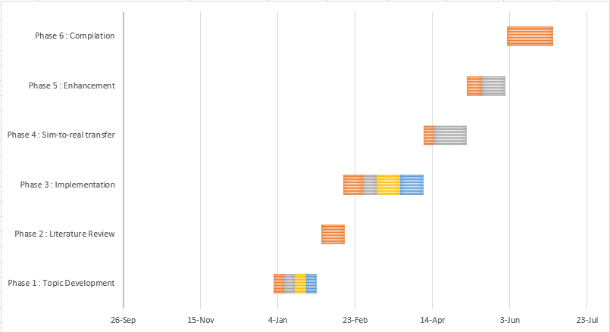
Plan
02/03/21
Phase 3 : Implementation : 52 days (mid Feb- early Apr)
Setting up the Reinforcement Learning Platform and Simulation environment : 13 days
Prepare a custom implementation taking existing states, actions, rewards : 9 days
Redefine actions and rewards for our use case : 15 days
Test the pipeline and iterate : 15 days

Slide 11
THANK YOU

